Slide 1
CAPSTONE PROJECT
INSOFE
TuringMinds.Ai
Telco Customer Churn prediction
03-04-2023
REDDAPPA M R

Slide 2

Telco Customer Churn

Slide 3
Telco Customer Churn
Problem Statement is to predict Telco customer churn.
Telcos apply machine learning models to predict churn on an individual customer basis and take counter measures such as discounts, special offers to keep their customers.
A customer churn analysis is a typical classification problem within the domain of supervised learning.
For this problem there are 8 steps to follow

Slide 4
Telco Customer Churn
Step1: Problem Definition
Step2: Data Collection
Step3: Exploration Data Analysis (EDA)
Step4: Feature Engineering
Step5: Train/Test Split
Step6: Model Evaluation Metrics Definition
Step7: Model Selection, Training, Prediction
Step8: Hyperparameter Tuning/Model Improvement

Slide 5
Telco Customer Churn
Step1: Problem Definition
The challenge is to predict if the individual customer will churn or not. To accomplish that, machine learning models are trained based on 70% of the sample data. The remaining 30% are used to apply the trained model and assess their predictive power with regards to churn or not churn.
To compare models and select the best model for the task, the accuracy is measured. Based on other characteristics of the data .

Slide 6
Telco Customer Churn
Step2: Data Collection
Data was given with the problem statement so moving to next steps.
The use of pipelines build-up is started with imports of some basic libraries that are needed throughout the case. This includes Pandas and NumPy for data handling and processing as well as Matplotlib and Seaborn for visualization.
In the local folder data was there, so read the Jupyter-notebook and stored in a Pandas Data Frame.

Slide 7
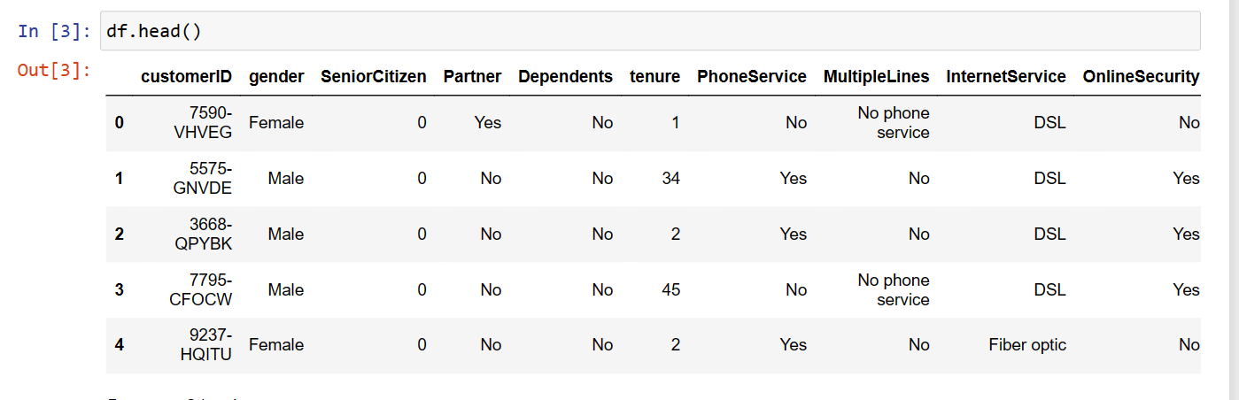
Telco Customer Churn
Step3: Exploratory Data Analysis
After data collection, several steps are carried out to explore the data. Goal of this step is to got an understanding of the data structure, conduct initial pre-processing, clean the data, identify patterns and inconsistencies in the data, build and validate hypothesis.
Understanding

Slide 8
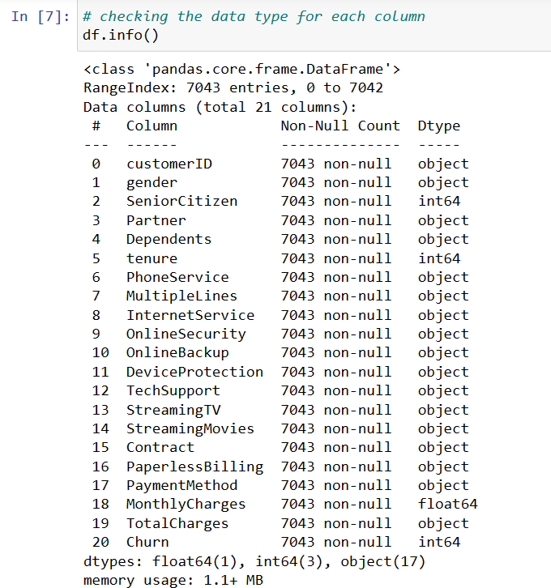
Telco Customer Churn

Slide 9
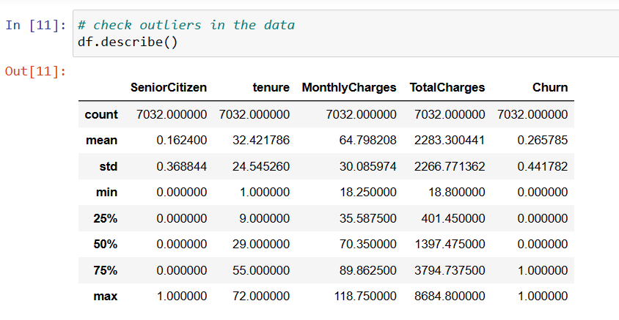
Telco Customer Churn

Slide 10
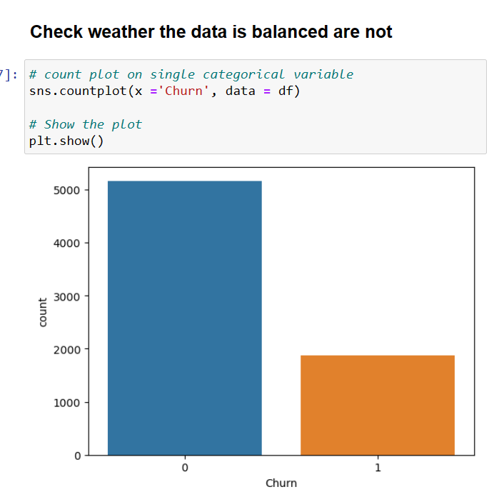
Telco Customer Churn
Meaning of feature churn
Churn – Whether the customer churned or not(Yes or No)

Slide 11
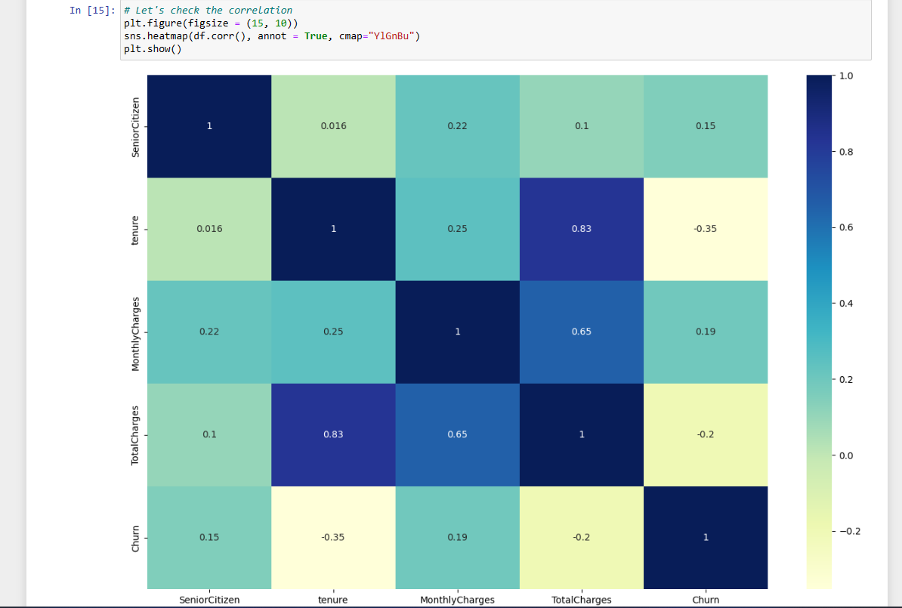
Telco Customer Churn
Correlation in the data
This plot says that the
Correlation between tenure
And totalcharges is 83% so
Remove any column

Slide 12
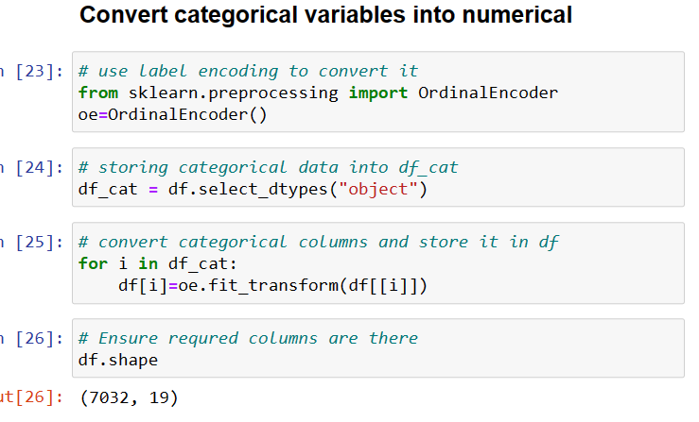
Telco Customer Churn

Slide 13
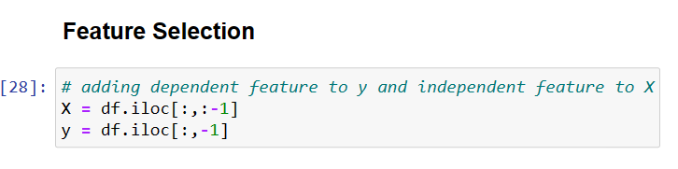
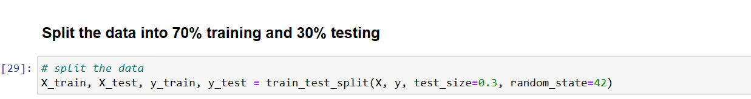
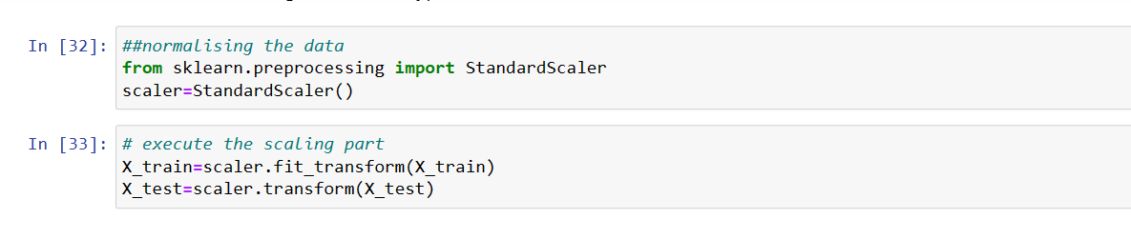
Telco Customer Churn

Slide 14
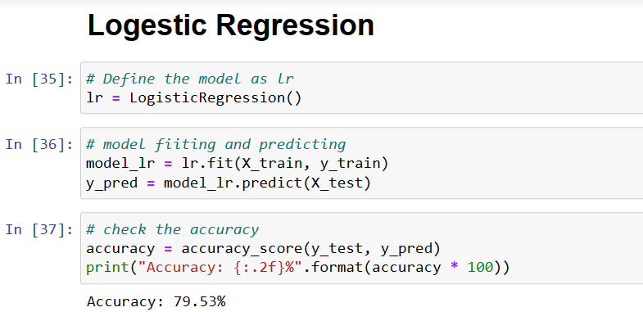
Telco Customer Churn

Slide 15
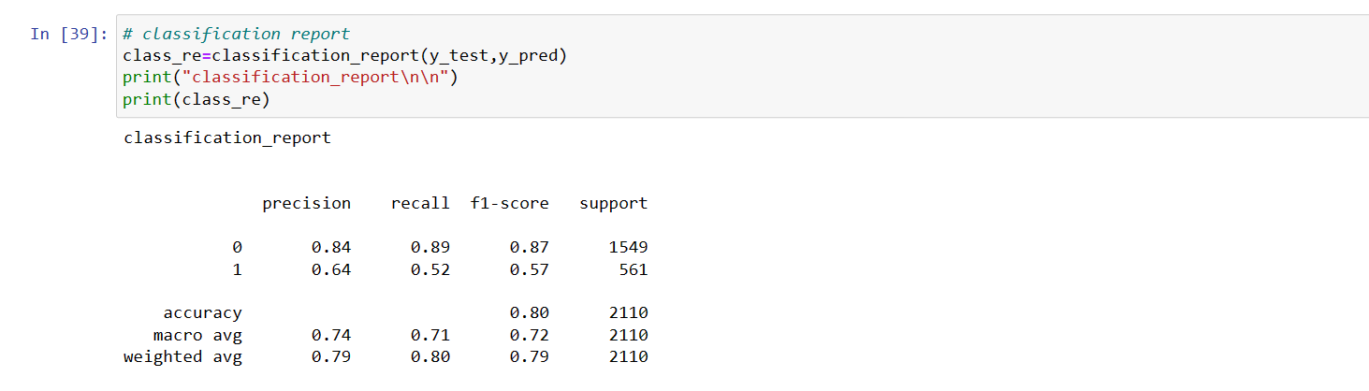
Telco Customer Churn

Slide 16
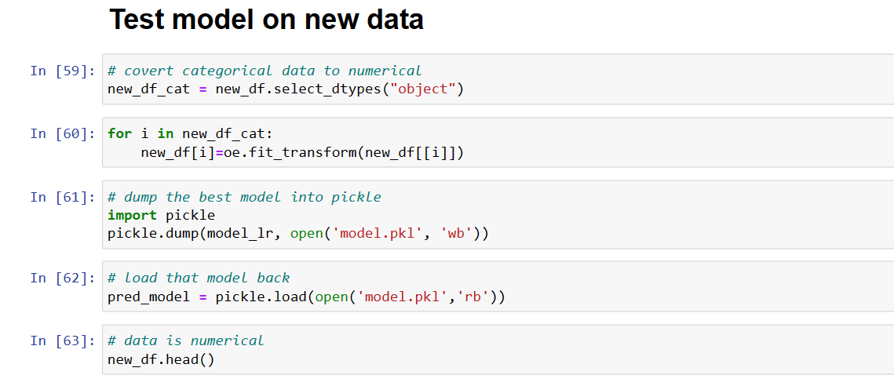
Telco Customer Churn

Slide 17
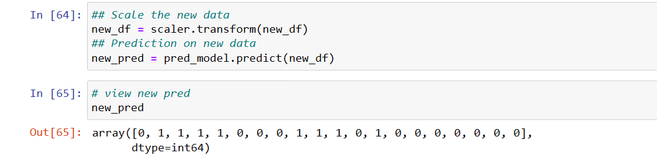
Telco Customer Churn

Slide 18
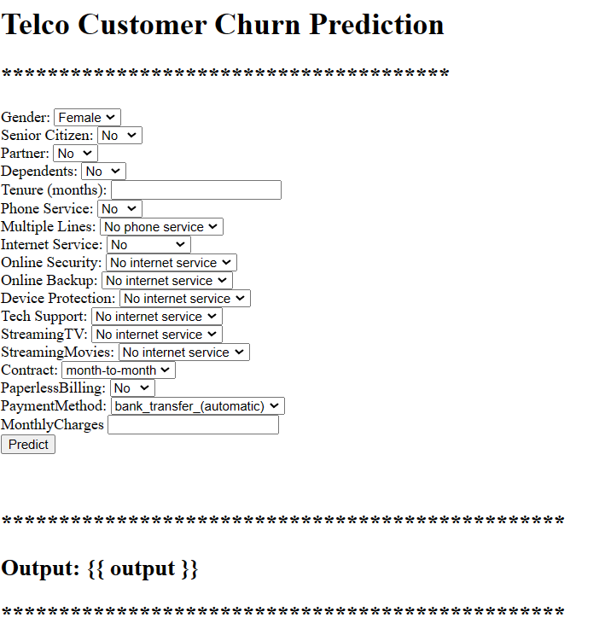
Telco Customer Churn
Html interface

Slide 19
Telco Customer Churn
Deployment:
using
Jenkins
Docker
Vs code

Slide 20
Telco Customer Churn
THANK YOU

